Slide 1
Data Analyst
Immo Eliza
Gregoire H
Marco B
Melih Y
Paul S

Slide 2
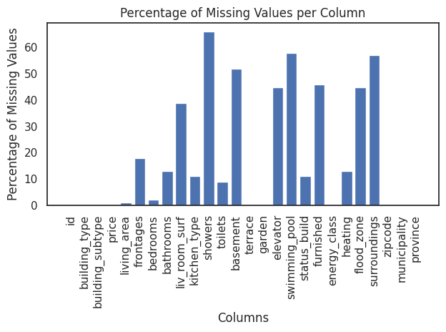

Slide 3
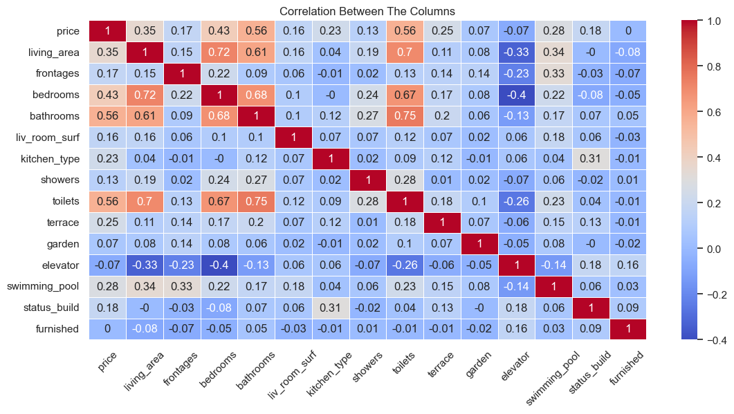

Slide 4
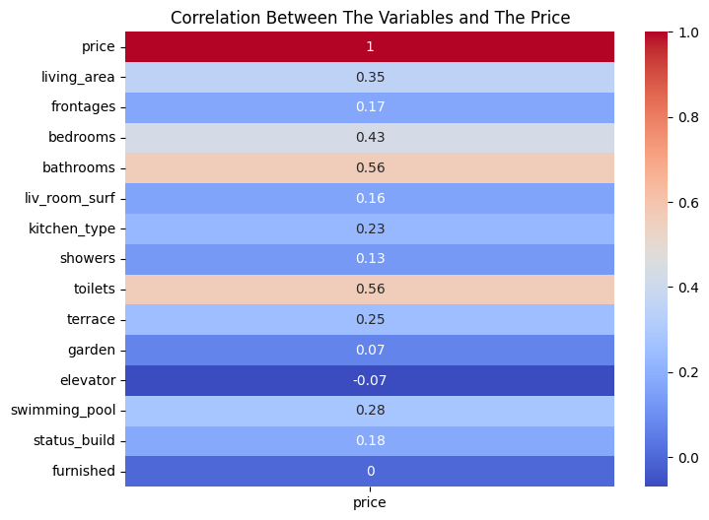

Slide 5
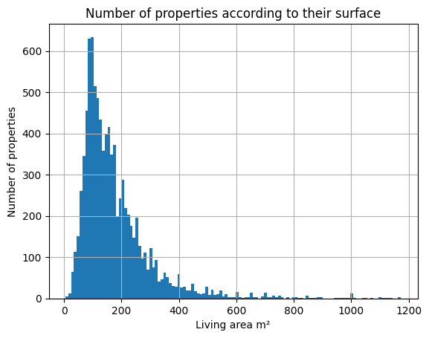

Slide 6
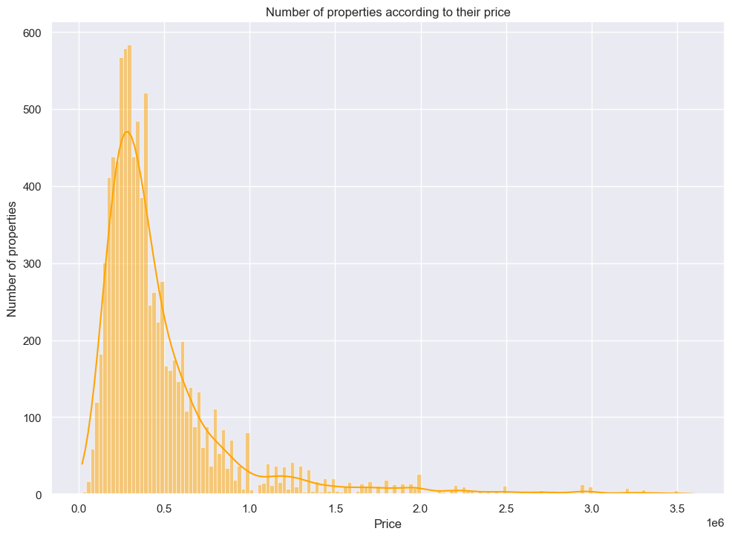

Slide 7
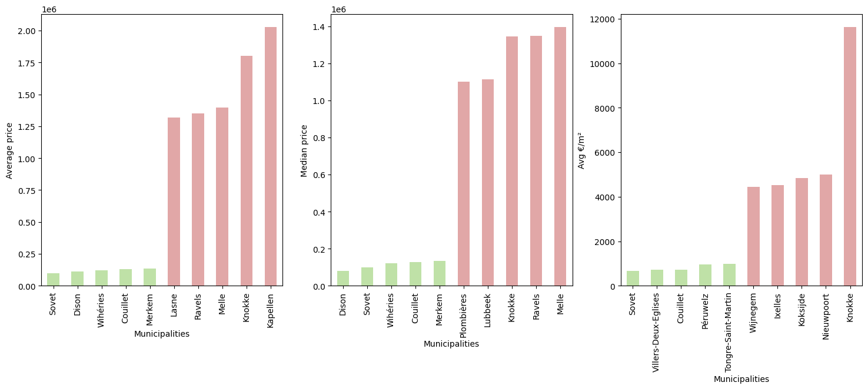

Slide 8
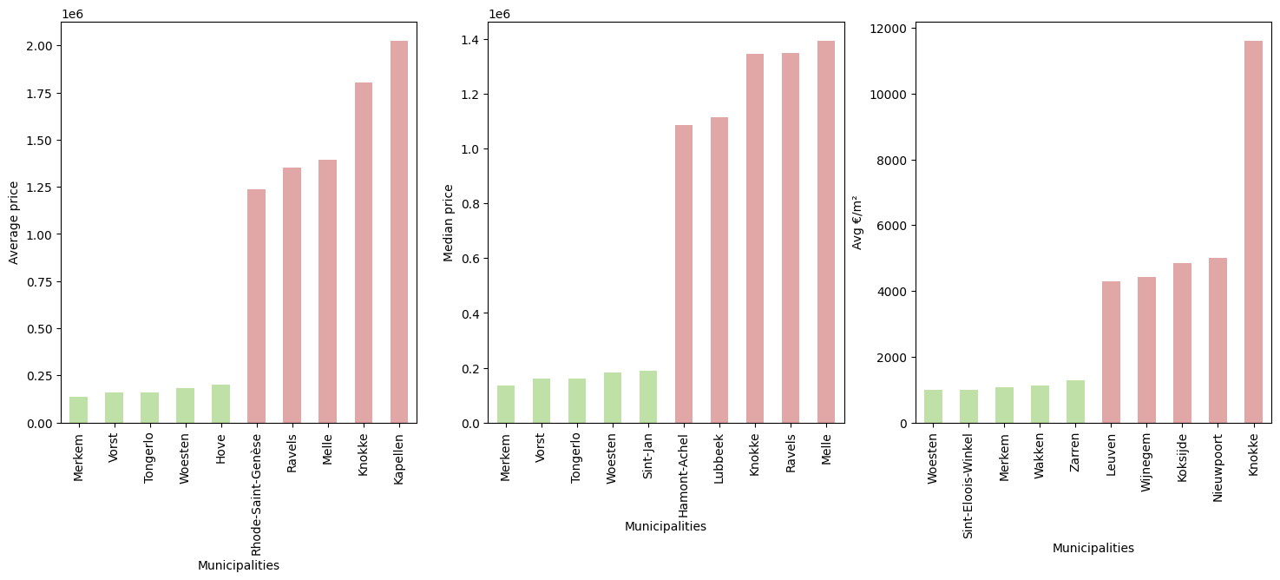

Slide 9
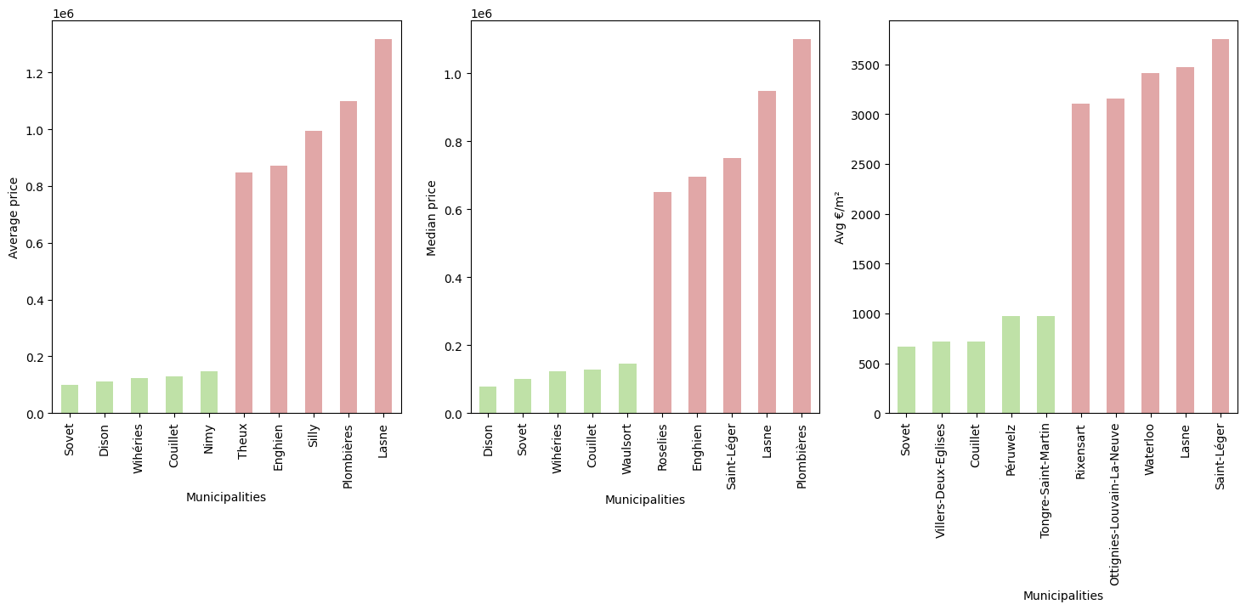

Slide 10
Living Area by Region

Slide 11
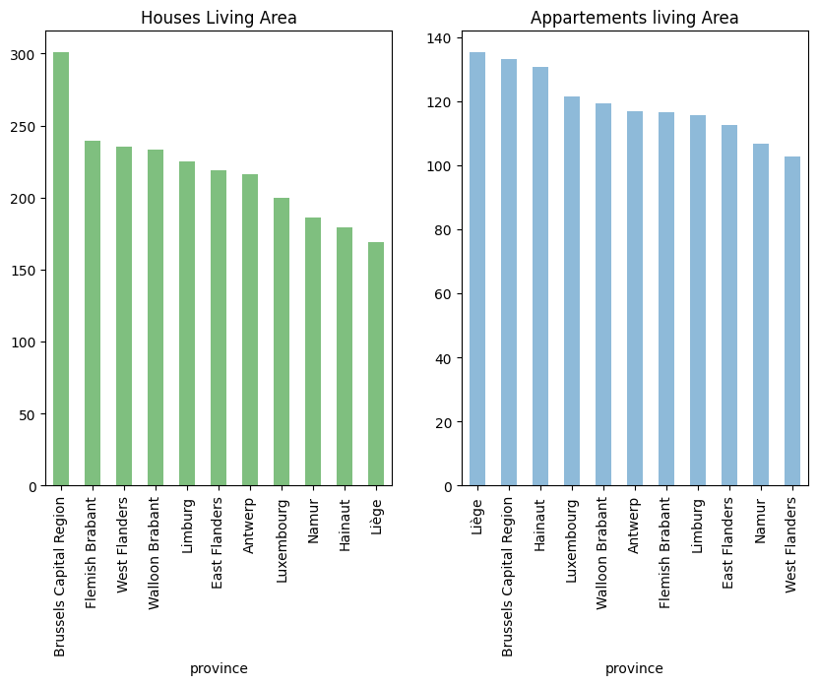

Slide 12
Real estate market in Belgium by region

Slide 13
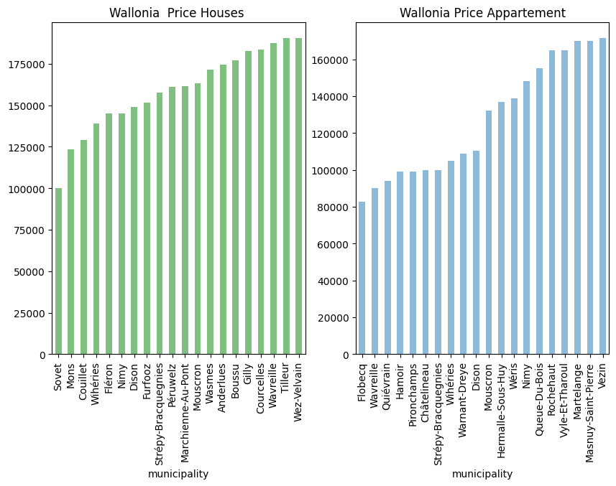
What are the less expensive municipalities in Wallonia?(Average price)

Slide 14
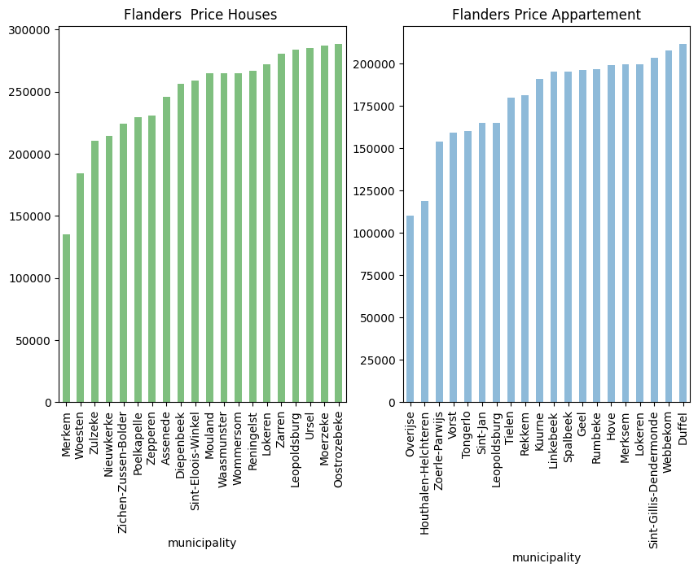
What are the less expensive municipalities in Flanders? (Average price)

Slide 15
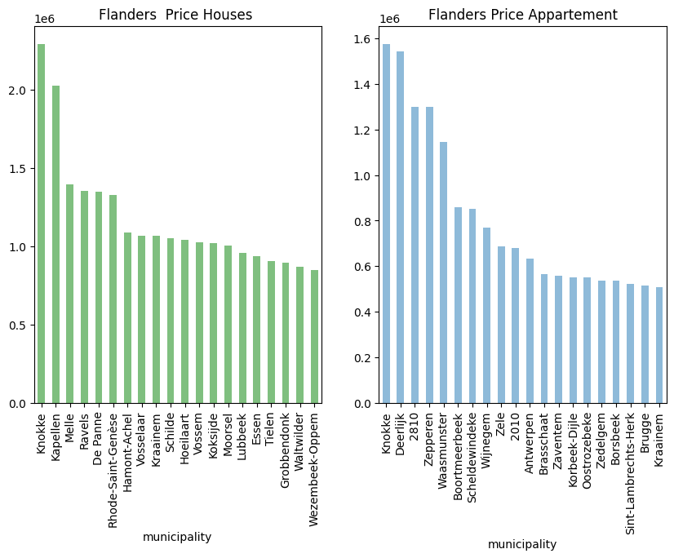
What are the most expensive municipalities in Belgium? (Average price)

Slide 16
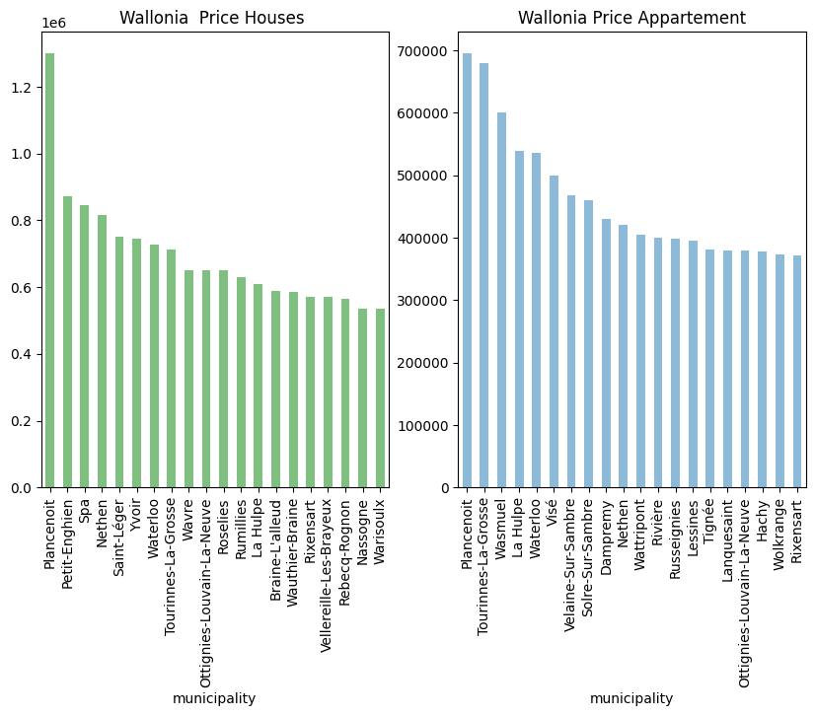
What are the most expensive municipalities in Belgium? (Average price)

Slide 17
Thank you for your attention

